Slide 1
Azure Boards
OW

Slide 2
What is Azure Boards??
Azure Boards is like a digital whiteboard where teams can plan their work. You can create tasks, organize them into lists, and track progress easily.
It's designed to work with agile methodologies like Scrum and Kanban. This means you can manage sprints, prioritize tasks, and adapt quickly to changes.
You can customize how work items flow through your team's process. For example, you can define stages like "To Do," "In Progress," and "Done" to reflect your workflow.
Azure Boards is a central hub for team collaboration. Members can discuss tasks, share updates, and stay aligned on project goals without switching between different tools.
By using Azure Boards, teams can streamline their development process, improve productivity, and deliver projects more efficiently.

Slide 3
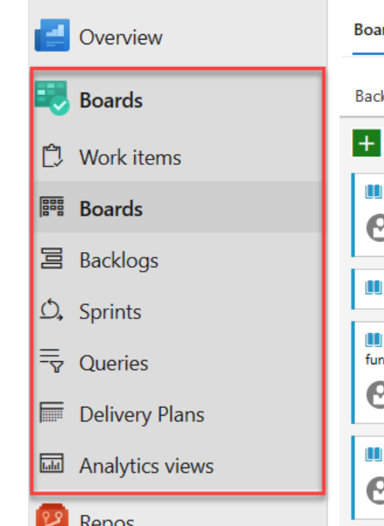
Azure Boards hubs UI

Slide 4
Integration
You can connect Azure Boards with GitHub repositories to link GitHub commits, pull requests, and issues to work items. Use GitHub for software development and Azure Boards to plan and track work. Quickly open linked GitHub commits, pull requests, or issues from the Kanban board.
Dashboards provide teams with customized views for status updates, progress tracking, and trend analysis. Teams can share information and improve workflows with flexible and tailored dashboard options

Slide 5
Kanban Board
A Kanban board is like a digital whiteboard where you and your team can plan and track your work visually. It's divided into columns that represent different stages of work, like "To Do," "In Progress," and "Done." Each task or work item is represented by a card that you can move between columns as it progresses.
The board helps you see at a glance what's being worked on, who's working on it, and where things might be stuck. You can easily update the status of tasks by dragging and dropping the cards, just like moving sticky notes on a real whiteboard. It's a great way to stay organized and keep everyone on the same page about what needs to be done and what's already completed

Slide 6
..
Visualizing Workflow: This means mapping out your team's workflow stages (like to-do, in progress, and done) and setting up a Kanban board that reflects these stages. Each task or item moves through these stages, making it easy for everyone to see what's being worked on and where it is in the process.
Limiting Work in Progress (WIP): Setting WIP limits means deciding how many tasks can be actively worked on at any given time in each workflow stage. This prevents overloading the team and helps maintain a steady workflow. For example, if your WIP limit for the "in progress" stage is 3, then the team can only work on 3 tasks simultaneously in that stage.

Slide 7
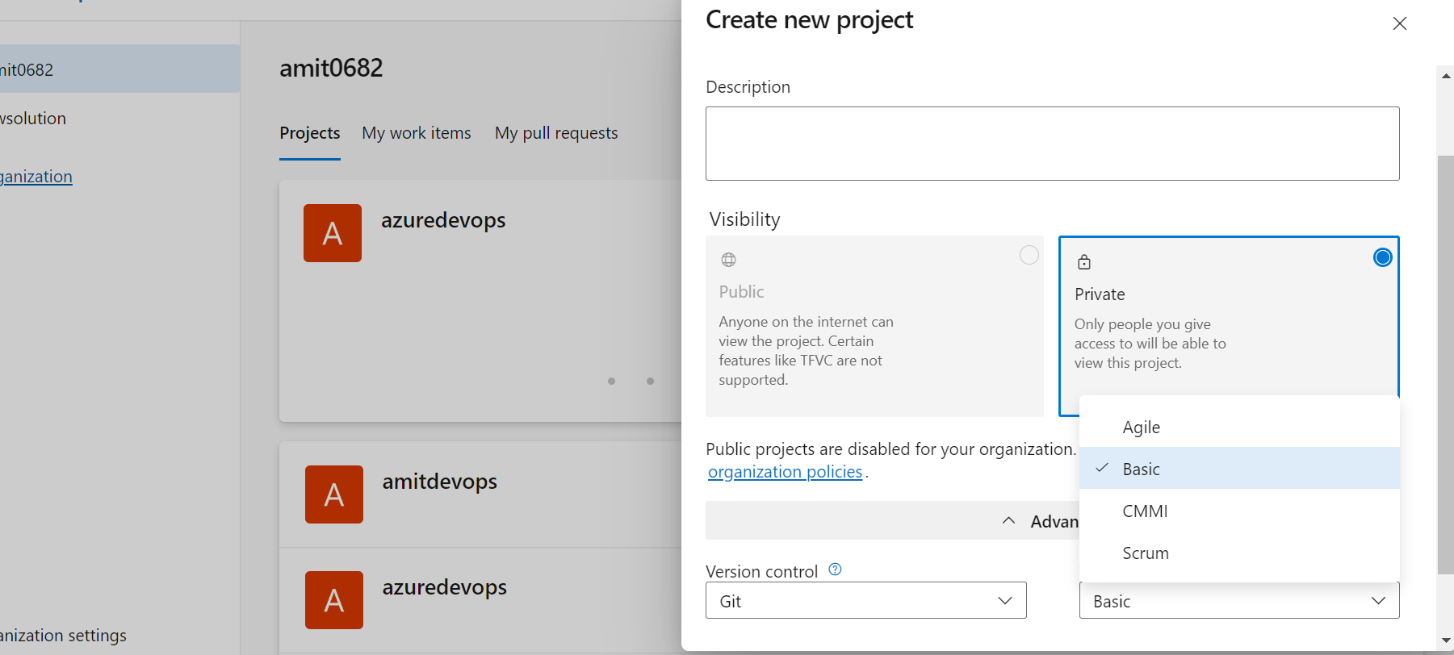
Process

